Slide 1


www.tarahtech.com

Slide 2
Data Cleansing, Missing Data Imputation and Outlier Detection

Slide 3

1.Missing Data Imputation
  Why missing values treatment is required?
  Why data has missing values?
  Checking for missing data
  Treating missing data
2. Outlier Detection and Treatment
  What is an Outlier?
  What causes Outliers?
  What is the impact of Outliers on a dataset?
  How to detect Outliers?
  How to remove Outliers?

Slide 4
Missing Data Imputation
  1.Why missing values treatment is required?
    Missing data leads to biased machine learning models.
    Affects the behavior and relationship with other variables.
    Can lead to wrong prediction or classification.
  2. Data can have Missing Values because of wrong
    Data Extraction
        Missing data can occur during data extraction process.
    Data collection
        These errors occur at time of data collection. There are 4 types of data
        collection errors.

Slide 5
    Missing completely at random
    Missing at random
    Missing that depends on unobserved predictors
    Missing that depends on the missing value itself
3. Checking for missing data
  In python, in order to check for outliers in a pandas data frame, function
  is.null() can be used.
  Example; Let df be a pandas data frame, and df.is.null() will give True for
  all the missing values present.

Slide 6
4. Treating missing data
  a) Deletion:
    Deleting missing data is the easiest process to eliminate the missing data. There are two types of deletions i) list wise deletion ii) pair wise deletion
  b) Mean/ Mode/ Median Imputation:
    Imputation is a method to fill in the missing values with estimated ones.
    Mean/median imputation deals with missing data by imputing mean of the all values of the same category.
    Mean and Median are used only for numerical data.
    Mode imputation is used for categorical data, it imputes the mode of that category.
    There are few more imputation techniques like KNN, Hot Deck imputation etc.

Slide 7
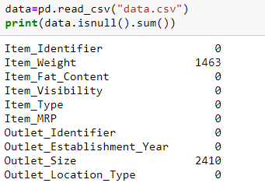
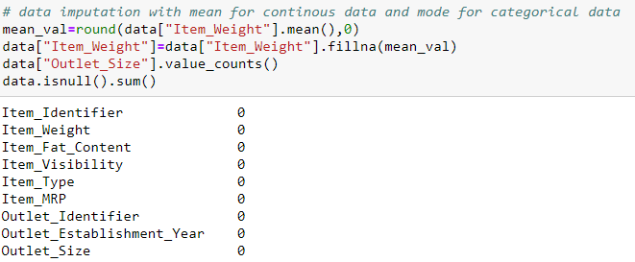
    The below two pictures show before and after missing data imputation.

Slide 8
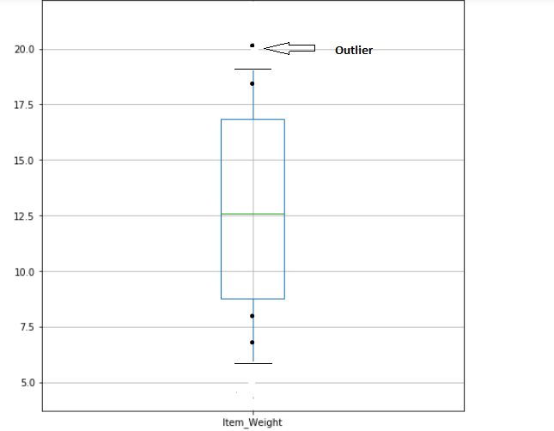
Outlier Detection and Treatment
  1.What is an Outlier?
  An observation that diverges from an overall pattern in a sample is called an outlier.
  Example; Salary of a CEO would be a outlier when comparing salaries of workers in a company.

Slide 9
2. What causes Outliers?
  Outliers can be formed either naturally or non-natural.
  Natural outliers can be like salary of a CEO in a company. These are not intentional but they exist as they should be.
  Non-natural outliers are due to :-
    a) Data Entry Errors
    b) Measurement Error
    c) Experimental Error
    d) Intentional Outlier
    e) Data Processing Error
    f) Sampling error

Slide 10
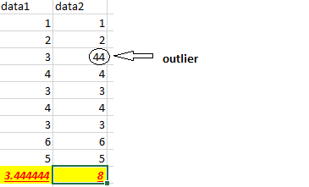
3. Impact of Outliers on a dataset?
  Outliers can influence results very drastically.
  They can increase the mean values and increase the error variance.
  If the outliers are non-randomly distributed, they can decrease normality
  They can bias or influence estimates that may be of substantive interest
  The above two columns are similar but due to influence of a outlier (44) in
  data2, the mean value has increased.

Slide 11
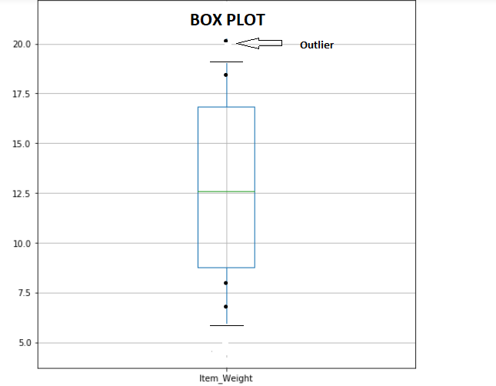
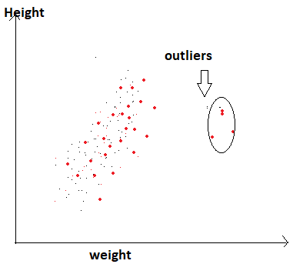
4. Detecting Outliers
  Outliers can be detected visually using Boxplot, Histogram(univariate) or Scatter plot(multivariate).
  Any value, which is beyond the range of -1.5 x IQR to 1.5 x IQR
  Values that are out of range of 5th and 95th percentile can be considered as outlier(capping method)
  Data points, three or more standard deviation away from mean are considered outlier

Slide 12
5. Removal of outliers
  Dealing with outliers is similar as dealing with missing values a)Deleting observations, b)Transforming , c)Binning , d)Treat them as a separate group, e)Imputing values etc.
  Deleting observations:
    We delete outlier values if it is due to data entry error, data processing
    error or outlier observations are very small in numbers.
  Transforming outliers:
    Transforming variables can also eliminate outliers. Natural log of a
    value reduce the variation caused by extreme values.
  Imputing outliers:
    Imputing outliers is similar to imputing missing values. Here, outliers
    are imputed with mean, median or mode values.

Slide 13
Summary:
Missing values occurrence and their imputations are talked along with the outlier occurrence, disadvantages of them in data and their imputations.
Note: Outliers deletion or imputation is done knowing if they have occurred artificially or not.

Slide 14
Thank You

